Slide 1
INFS3201
PATH Variables
nodemon

Slide 2
Background
Today’s topic is unrelated to Web Programming but may be necessary in some cases to make the ‘nodemon’ program work.

Slide 3
Command Line Systems
Most operating systems have a command line interface.
When you type a command at a terminal window, the terminal searches your computer looking for the command.
Example when you type “ls” in Linux, you are actually running the program ‘/bin/ls’
Where does the computer look?

Slide 4
PATH Environment Variable
Most Operating Systems allow for variables to be defined to perform different operations.
One variable that is used in multiple systems (Linux, Windows, Mac) is called ‘PATH’.
The ‘PATH’ is a list of folders that the operating system will search through when you type a command.
When you install some programs, the PATH variable is updated.

Slide 5
Example
This is a Windows computer showing the PATH variable.
If you type ‘nodemon’ on this system, the OS will look in “c:\windows\system32” for the program called nodemon. If it is found then the program is executed, otherwise it moves to the next item in the list. So the OS will then search in c:\windows.
If we reach the end of all the folders in the list, the OS will claim that they do not know about the program nodemon.
If you want to see the path in Linux or MacOS, you can type:
echo $PATH

Slide 6

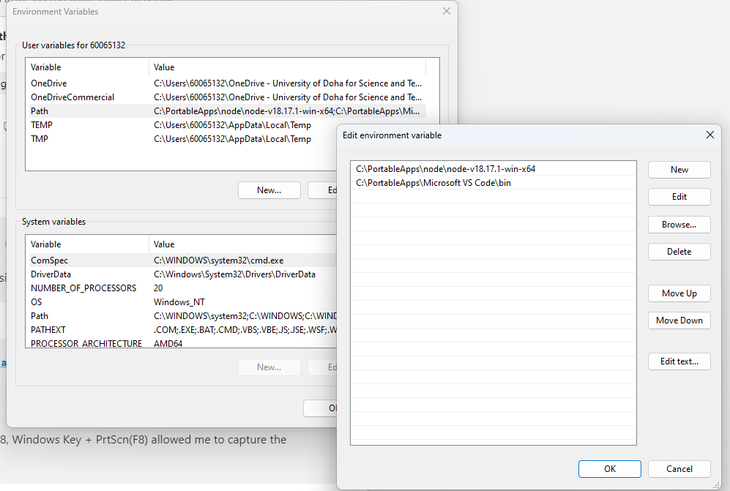
Modifying The Path In Windows
Type ‘environment’ into the search area and pick the option shown for modifying variables in your account.
Pick the ‘Path’ under ‘User Variables’ then edit.
Add the appropriate new folder you want to scan and click okay.
You will need to close the terminal and reopen for the changes to work.

Slide 7
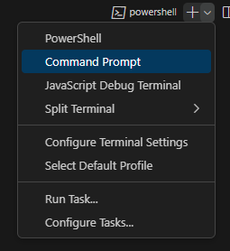
Nodemon in 10.2.16 and 10.2.32
The new setup where we must login using the Azure credentials causes problems with the command
‘npm install –g nodemon’.
The package is installed when you run the command but the PATH variable is not updated automatically.
The usual location for the nodemon program to be installed is
c:\Users\60061234\AppData\Roaming\npm
If this path is added (change your id number) to the PATH and the terminal/VSC restarted then you will have access to the nodemon command but you must use a command prompt and not a PowerShell terminal.

